Slide 1
Topic 2
What sweet music!
Section A
咸宁实验外国语学校
定梦君

Slide 2
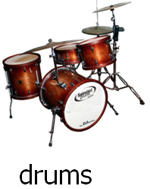
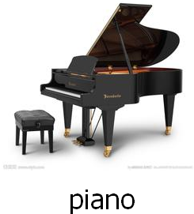
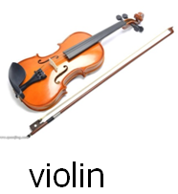

Slide 3
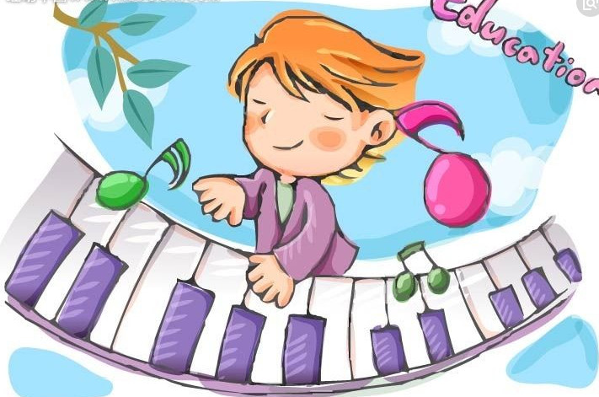
Play a game.
Body Instrument

Slide 4
Group Piano

Slide 5
Group Drums

Slide 6
Group Violin

Slide 7
Group Guitar

Slide 8
Group Erhu

Slide 9
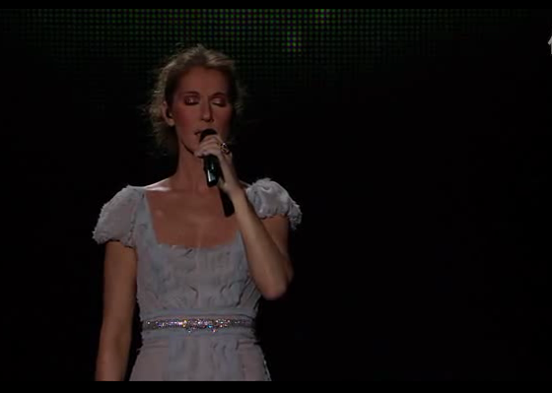
Watch the video.
My Heart Will Go On
--- Celine Dion
What do you think of the music?

Slide 10
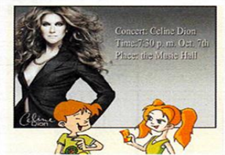
Look and say.
Concert: Celine Dion
Time: 7:30 p.m. Oct. 7th
Place: the Music Hall
poster

Slide 11
Listen to 1a, and answer the following questions.
1. What is Sally going to do this Sunday evening?
2. What is Jack going to do?
3. What can Sally do for Jack?
She is going to a concert.
He is going to watch movies with Steve.
She can lend him some CDs of Celine Dion.

Slide 12
Put them in the right order.
2
1
4
5
3
How exciting!Who is going to sing at a concert?
Celine Dion.Do you know the song My Heart Will Go On?
Yes. Is that her song?
Right. And it sounds beautiful!
What are you going to do this Sunday evening?
I'm going to a concert.
1
2
What a pity! Hmm... I can lend you some CDs of her songs.
I think you will enjoy them.
Thanks a lot.
You're welcome.
Where is she going to give a concert?
At the Music Hall.
4
3
Oh, wonderful! What time is it going to start?
At 7:30p.m. Why not come with me?
I’d like to, but I am going to watch movies with Steve.
5

Slide 13
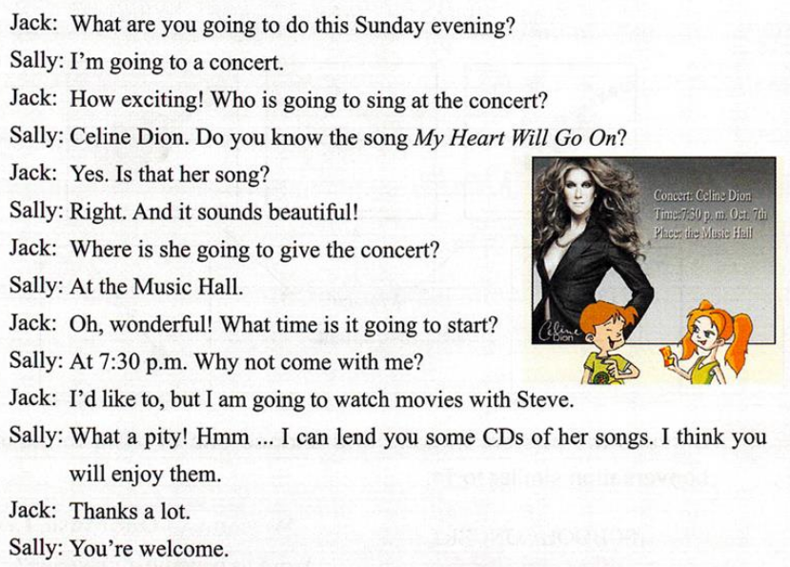
1a
Can you find out the sentences to show their feelings?

Slide 14
Project
Here are some posters for you.
You need to make a dialog(对话) like 1a.

Slide 15
Show Time

Slide 16
Summary
1. We have learned some new words:
instrument drums violin concert pity lend
2.We have learned some sentences to show feelings.
e.g. How exciting! What a pity!
3.We have learned how to talk about a poster.

Slide 17
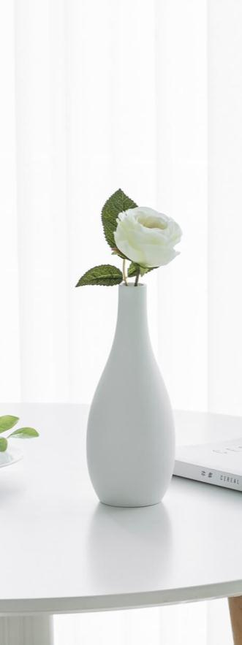
Enjoy the music!
Enjoy the life!

Slide 18
Students’ Self-assessment Table(学生自评表) Class ________ Name ________
 | very good | just so-so | not so good
1. I can listen carefully in the class.
2. I can answer questions in the class.
3. I can take part in the class activities actively.
4. I enjoy myself in the class.
5. I can work with my partners happily.
6. What question do I have about the class? (You can ask the teacher.)
7 What suggestions do I have for the teacher? (You can tell the teacher.)

Slide 19
Homework
A. Collect more expressions to show good feelings
and bad feelings.
B. Make a poster about a concert in English.
My email address: evaxnwgy@163.com

Slide 20
THANK YOU!

