Slide 1
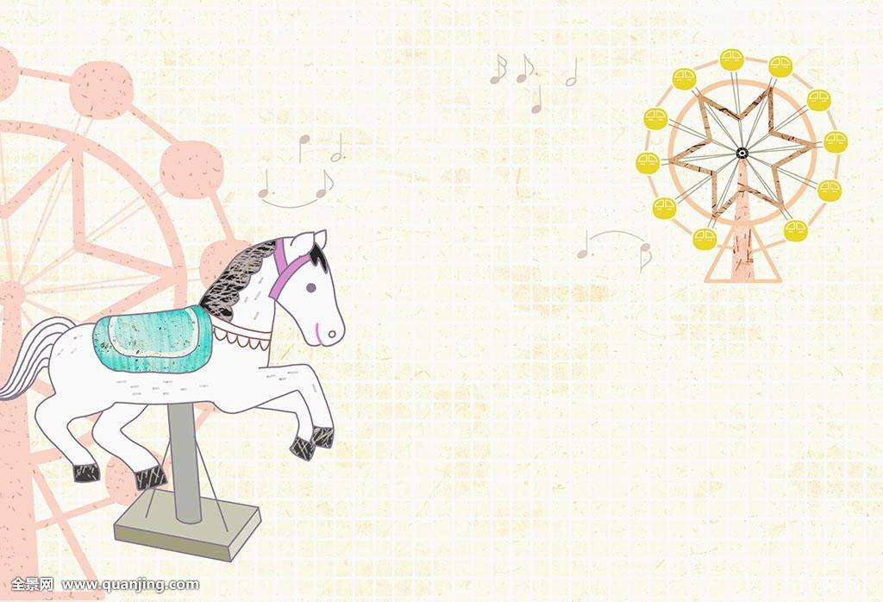
TOPIC 2 What sweet music!
Section B
（1a~2）
咸宁市温泉中学
胡雯君

Slide 2
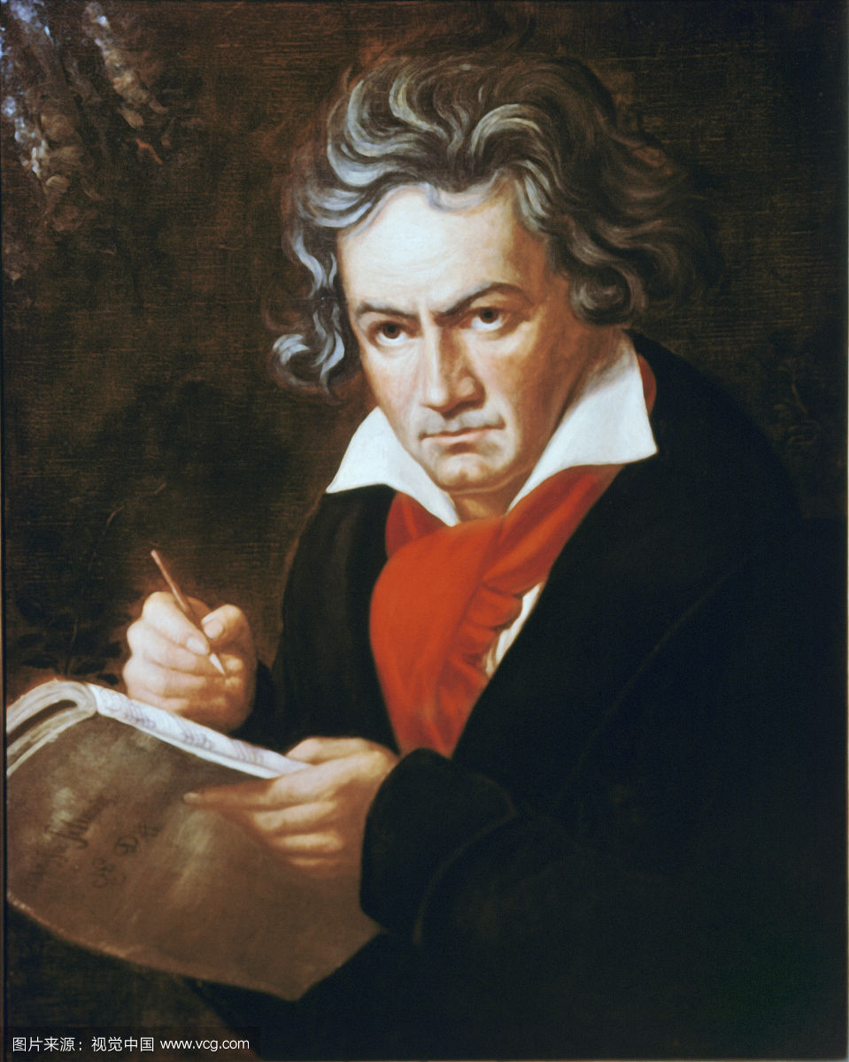
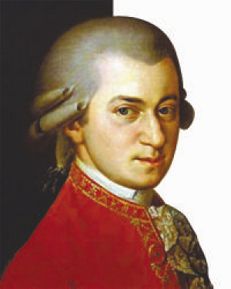
Lead-in
/taɪp/ n. 类型，种类
Some Types of Music
/'klæsɪkl/ adj. 古典的
classical music
Beethoven
Mozart
They wrote great classical music.

Slide 3


Lead-in
Some Types of Music
pop music
It's popular with young people.

Slide 4

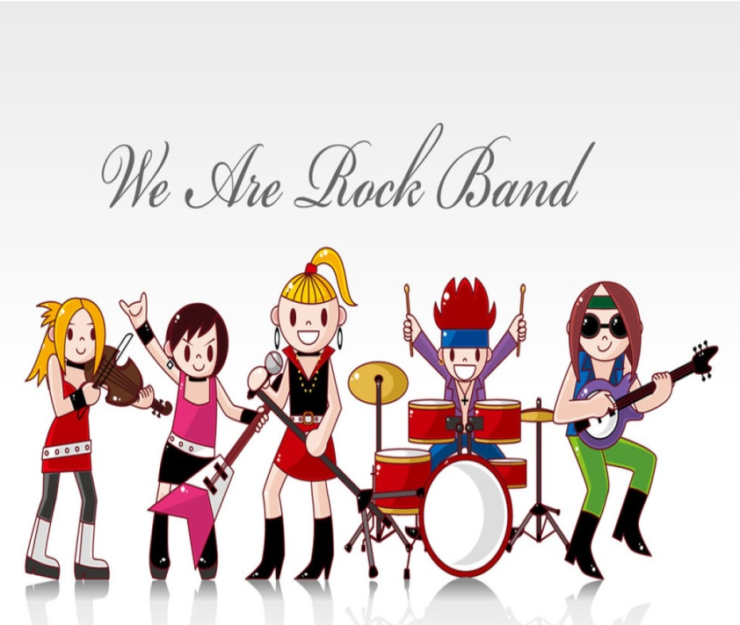
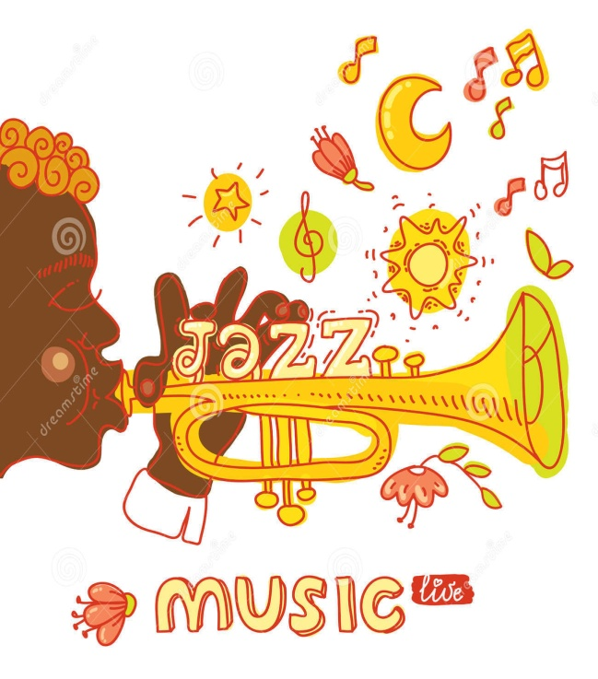
Lead-in
Some Types of Music
/rɒk/ n. 摇滚乐
/dʒæz/ n. 爵士乐
country music rock music jazz
pop music

Slide 5
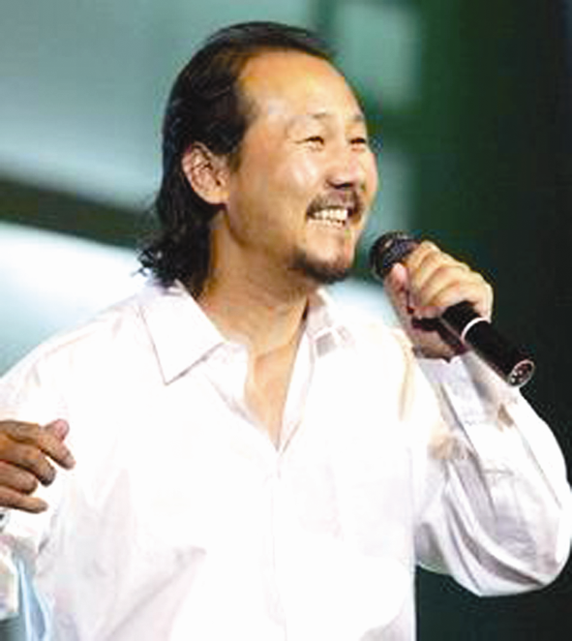
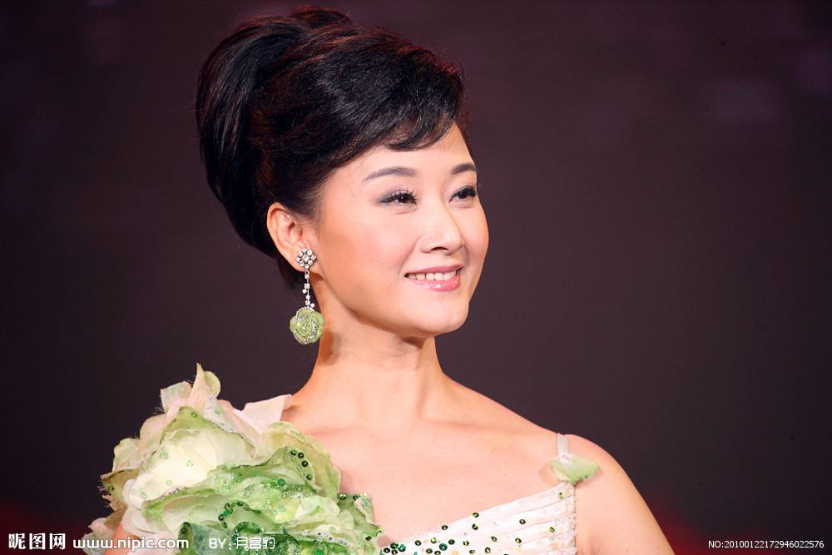


Lead-in
Some Types of Music
/fəʊk/ adj.民俗的
folk music
They are famous for their folk songs.
You hate listening to folk music.
Folk music is not my favorite, but I don't mind it.

Slide 6
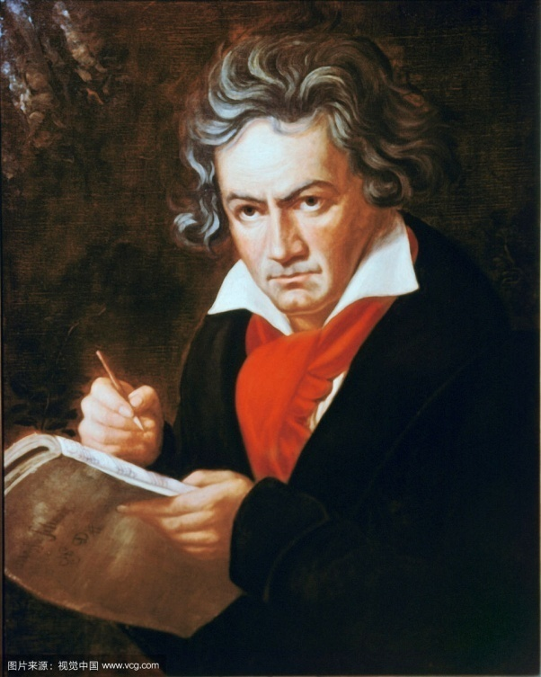
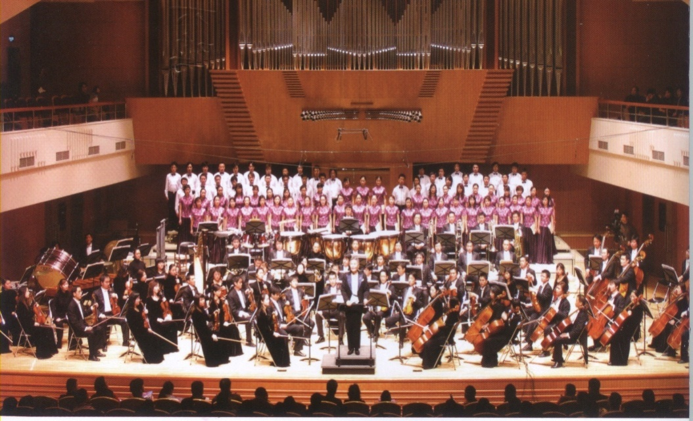
2
Groupwork. (Fill in the blanks.)
Classical music is s_______ music. People usually e_____ it at a concert or in a theater. Beethoven and Mozart wrote great classical music.
erious
njoy

Slide 7

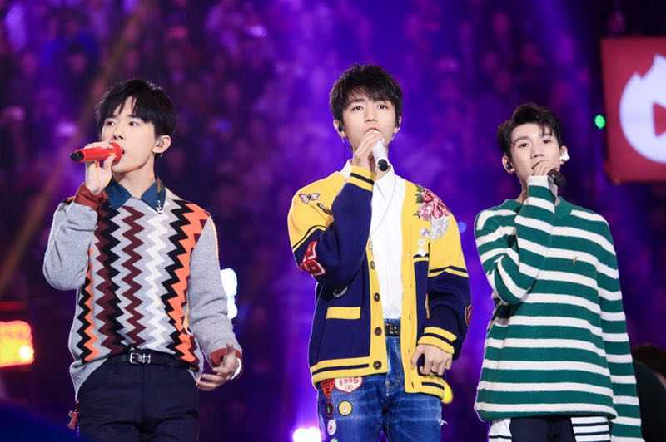
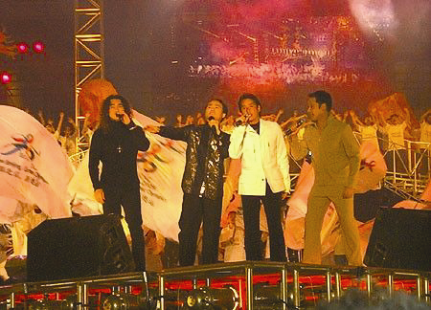
2
Groupwork. (Fill in the blanks.)
Pop music often comes and g____ quickly. It is usually about l____ and everyday life. Country music, rock music and jazz are all pop music. They are very p_______ with young people.
oes
ove
opular

Slide 8
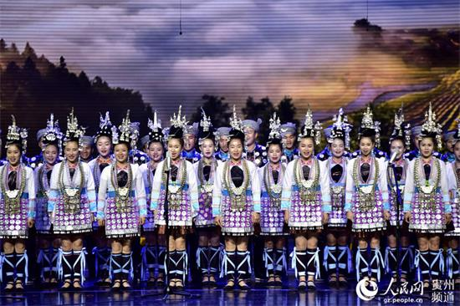
2
Groupwork. (Fill in the blanks.)
Folk music is special. It is a part of the working people’s songs. Guo Lanying, Song Zuying and Tengri are f______ for their folk songs.
amous

Slide 9
2
Chain work. (Ask and answer.)
classical music country music rock music jazz folk music
A: What kind of music do you like?
B: It's hard to say. I used to like ______ music, but now I like______ music.

Slide 10

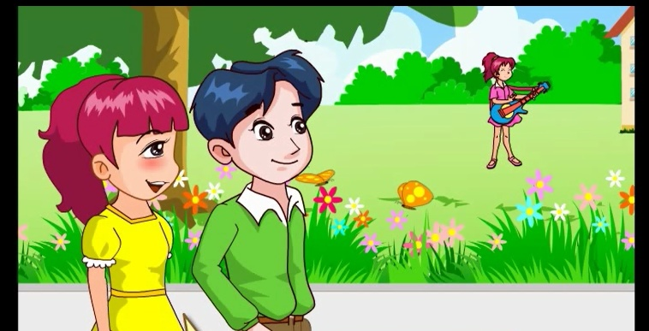
1a
Pre-listening (Answer the following question.)
Did Li Ming use to enjoy pop music?

Slide 11
1b
While-listening (Listen and fill in the table.)
Name | Like |  | Dislike | Reason for dislike
 | Used to | Now
Li Ming
Jane
pop music
folk music
classical music
serious
country music
rock music
noisy
jazz

Slide 12
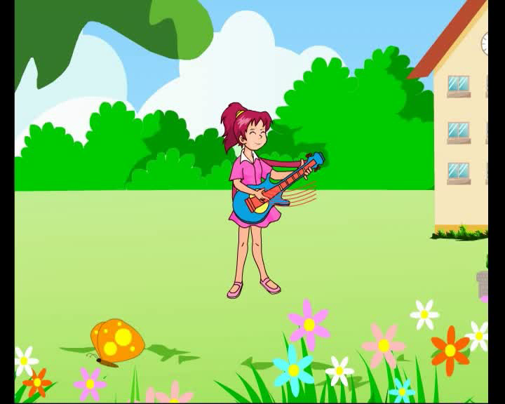
1b
While-listening (Watch the flash and repeat.)

Slide 13

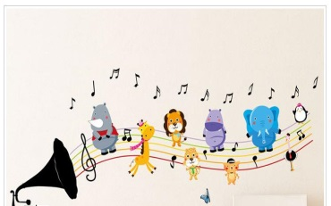
Pairwork
1. Practice the conversation with your partner.
2. Act it out.

Slide 14

Groupwork
Project
Interview your friends about their favorite music then report.

Slide 15
Summary
We learn
New words and phrases:
Useful expressions :
folk, classical, rock,jazz,type,quickly,
be famous for...
What kind of music do you like?
I used to enjoy pop music,but now I like folk music.
I don't like it at all.
It's not my favorite, but I don't mind it.
I hate listening to rock music.
I think it's too noisy.
We can
Know about some types of music.
Express the feelings about music.

Slide 16


Slide 17
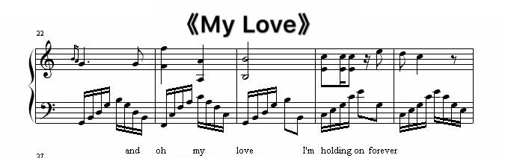

Slide 18

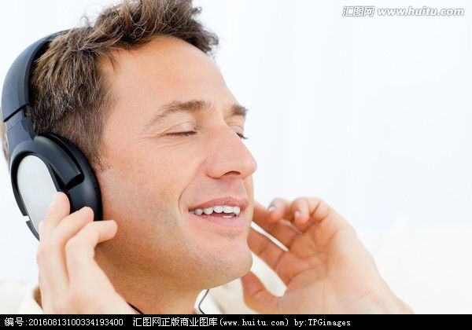


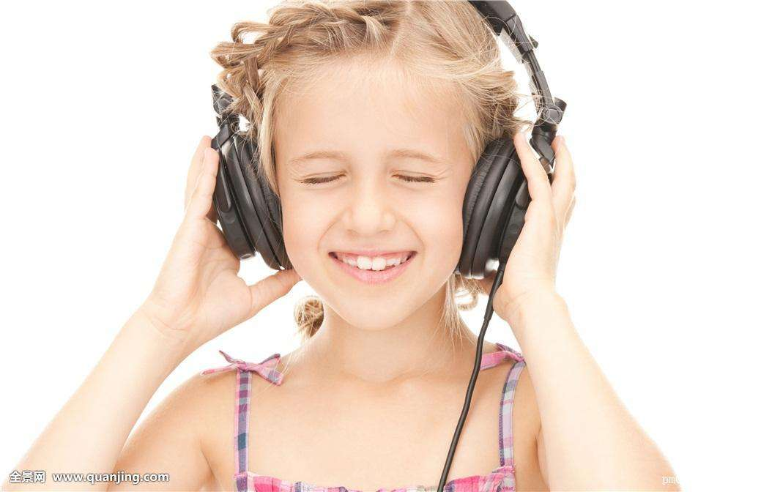
Music can give us love and energy!

Slide 19
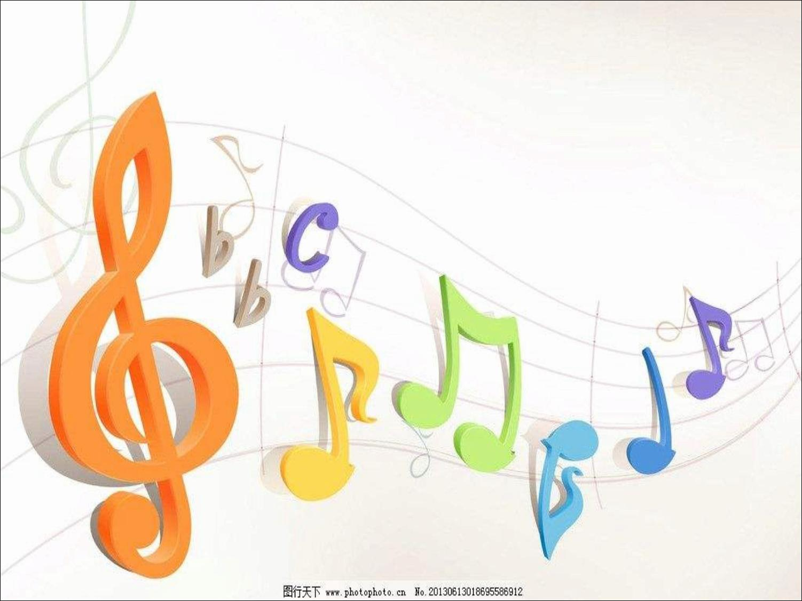
Homework
Sing a song that can express the love in your heart to your parents or teachers.

Slide 20

Thank you !

