Slide 1
课程名称：I like music that I can dance to.
年级：九年级全一册
版本：人教版新目标
主讲教师：褚阿娜
工作单位：湖北省孝感市文昌中学

Slide 2
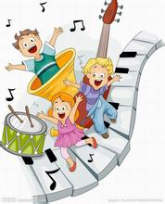
Unit 9
I like music that I can dance to.
Section A
1a---2c

Slide 3
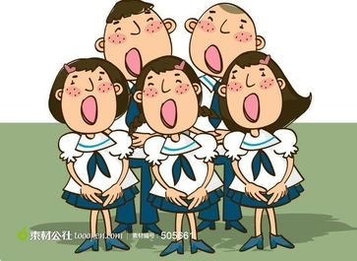
情境引入
Let's sing!
This is a children’s game from Africa.
It’s an echo(回音) song. So when you hear
me sing it, you sing it back to me. Listen
carefully.
(solo) Che che koolay, (echo)
(solo) Che che kofeesa, (echo)
(solo) Kofeesa langa, (echo)
(solo) Kakashee langa, (echo)
(solo) Koommadyeday, (echo)

Slide 4
情境引入
Let's sing!
Let’s do it in English this time.
Do what I do .
Hands on your head
Hands on your shoulders
Hands on your waist(腰)
Hands on your knees
Hands on your ankles(脚踝)

Slide 5
情境引入
What kind of music do you like?
Why?
guitar
music
classical
music
loud
music
beautiful/interesting
country
music
violin
music
relaxing/exciting
light
music
loud/quiet
rock
make me happy/sad
piano
music
make me relaxed
pop
dance
music
music tree
music

Slide 6
知识呈现
Enjoy the music
I like
music .
I can dance to .
it.
I like
music .
that
I can dance to .
it.

Slide 7
知识呈现
You are my sunshine
You are my sunshine my only sunshine You make me happy when skies are grey You'll never know dear how much I love you Please don't take my sunshine away The other night dear as I lay sleeping I dreamed I held you in my arms When I awoke dear I was mistaken So I hung my head and cried
I like
music .
I can sing along with .
it.
跟着…一起唱
I can sing along with .
I like
music .
that
it.

Slide 8
知识呈现
You are my sunshine
You are my sunshine my only sunshine You make me happy when skies are grey You'll never know dear how much I love you Please don't take my sunshine away The other night dear as I lay sleeping I dreamed I held you in my arms When I awoke dear I was mistaken So I hung my head and cried
歌词
I like
music
better.
It
has great lyrics.
prefer = like…better
I prefer
music.
that
It
has great lyrics.

Slide 9
Listen and repeat
活动探究
Task One
I like music that I can dance to.

Slide 10
活动探究
Task One
I prefer music that has great lyrics.

Slide 11
活动探究
Task One
I love music that I can sing along with.

Slide 12
活动探究
Task One
I like music that isn’t too loud.

Slide 13
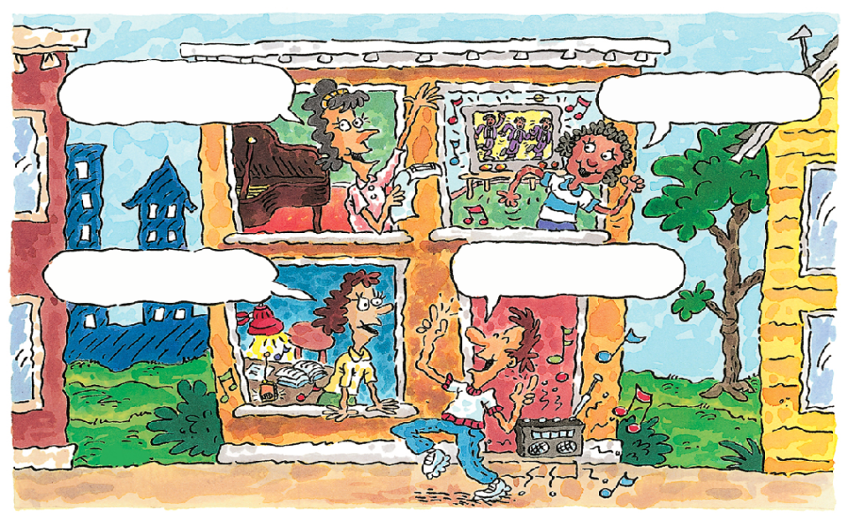
活动探究 Task Two
I prefer music
that has great lyrics
I love music that
I can sing along with.
I like music
that isn’t too loud
I like music that
I can dance to.
1a.What kind of music do you like ? Write your own sentences.
I like the music that ___________________.
I prefer the music that _____________________.

Slide 14
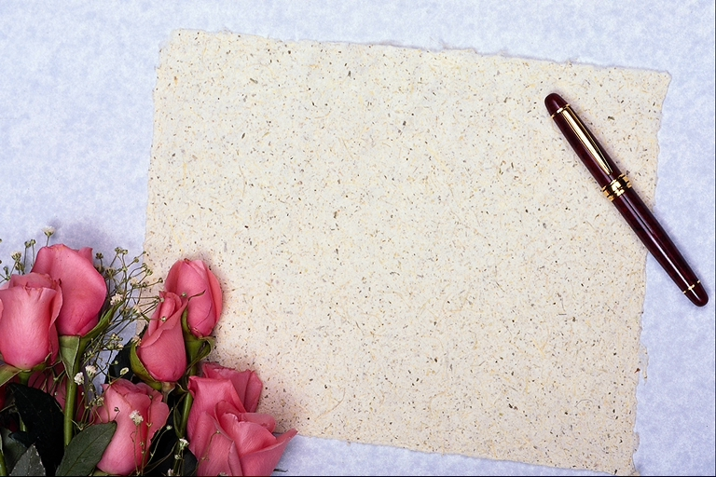
活动探究 Task Three
Talk about the music you like.
Pair work
A: What kind of music do you like ?
B: What about you?
A:
I like music that _____.
I prefer music that _______.
is beautiful/relaxing/exciting
is quiet/isn’t too loud
makes me happy/sad/relaxed/excited
I can dance to
I can sing along with
has great lyrics

Slide 15
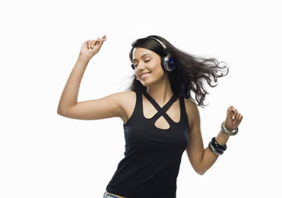
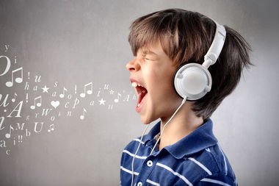
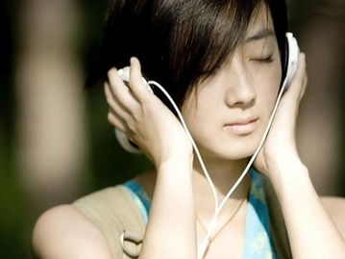
延伸拓展 Task One
Guess
Listen to the following music, and guess what kind of music she/he likes.
make people confident
remind them of their childhood
encourage people

Slide 16
延伸拓展 Task Two
Listen and check the kinds of music Tony and Betty like.
1b
Listening
 | Music that I can dance to | Music that has great lyrics | Music that I can sing along with
Tony
Betty
√
√
√
√
Fast speaking
that has great lyrics
Tony likes music __________________and he likes music_________________________.
Betty likes music ___________________and she likes music _________________________.
that he can sing along with
that she can dance to
that she can sing along with

Slide 17
延伸拓展
Task Three
Make a survey!
Group work :
What kind of music do you like?
Names
What kind of music do you like?
Make a report:
In my group, …likes the music that …
…prefers the music that …

Slide 18
I like the trees that are green,
I like the sky that’s full of sunshine,
I like the moon that’s able to smile,
I like the world that’s full of love.
He likes the trees that are green,
He likes the sky that’s full of
sunshine,
He likes the moon that’s able to smile,
They are my sunshine.
实际运用
Enjoy a song

Slide 19
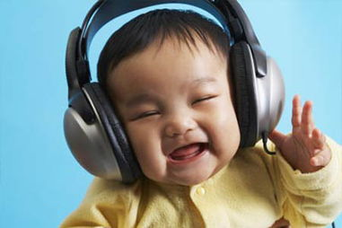
情感教育
Enjoy music and feel good about the life
Love music and love the world

Slide 20
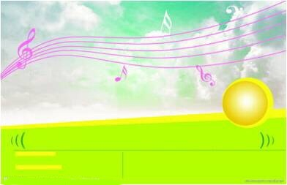
归纳总结
summary
1. Key words:
lyrics, prefer
2. Sentences:
I like music _____ I can sing along with.
I like music ______ I can dance to.
I prefer music _________________ .
that has great lyrics
3.Grammar focus:
In the attributive clauses(定语从句)
things

Slide 21
活学活用
A
game
谁
是
小
博
士
？
(抽签答题)
(难度系数)

Slide 22
单项选择：
I like music I can sing along with.
A. that
B. what
+ 100

Slide 23
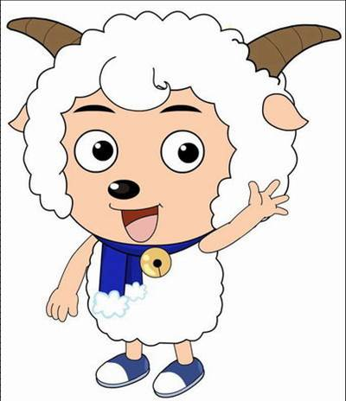
No Questions for you.
You're lucky!
+ 100

Slide 24
补全单词:
I p music that I can sing a with.
refer
long
+ 200

Slide 25
改错:
to
I like music that I can dance .
+ 200

Slide 26
同义句:
I like loud music better.
I music loud.
prefer that is
+ 300

Slide 27
Translate it into English.
翻译
Tom喜欢有好歌词的音乐。
that has great lyrics
Tom likes music .
+ 300

Slide 28
连词成句:
prefer, I, that, music, loud, isn’t, too,
I prefer music that isn’t too loud.
+ 300

Slide 29
Homework
Change the lyrics of a song using the sentence pattern that we learn
today, and share it with your classmates.

Slide 30
Thank you!
Goodbye!

