Slide 1
A Reading Class of Grade 8
------Someday
School: No.35 Middle School
Teacher：Zang yonghui

Slide 3
1.Who wrote this article?
2.“I” refers to___“You” refers to ___
3.What`s the mom doing now?

Slide 4
Read & Think
1.Find out different stages（阶段）in the daughter`s life
2.Where are the stages ?

Slide 5
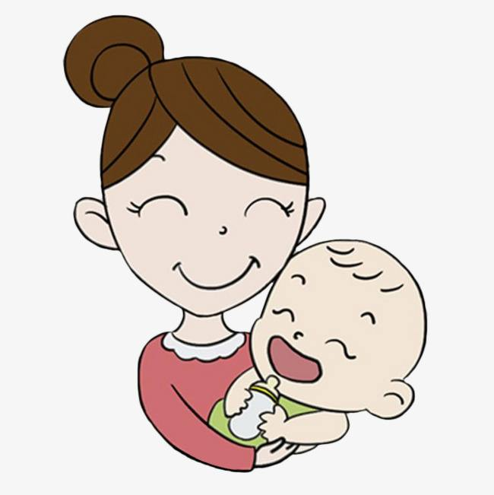
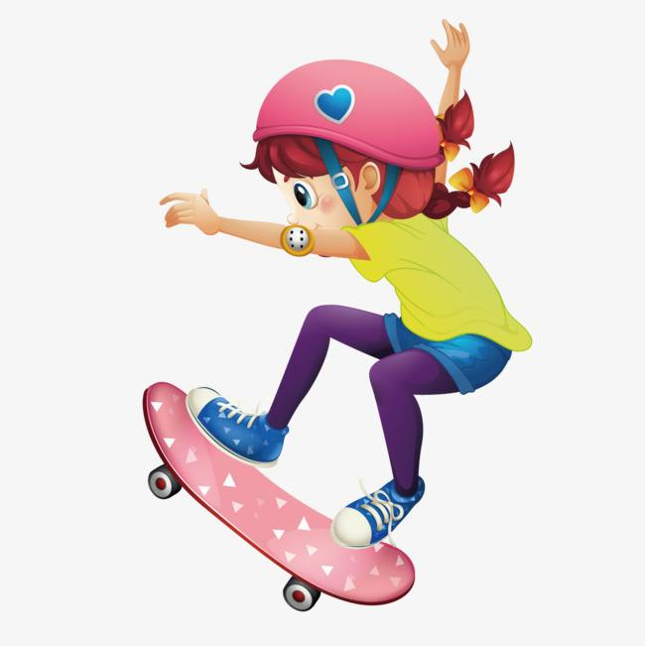
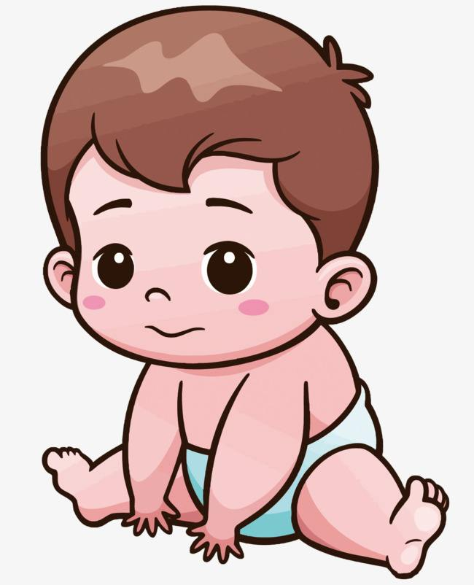
Mom
Young lady
Teenager
Child
P15-P18
Baby
P13-P14
P6-P12
P4-P5
P1-P3

Slide 6
1.What did the mom do for her baby?
2.How did the mom feel ?

Slide 7
Mom
Young lady
Teenager
Child
P15-P18
Baby
P13-P14
P6-P12
P4-P5
P1-P3

Slide 8
What will the teenager do?
How will the teenager feel?
The mom expects her daughter to be ...

Slide 9
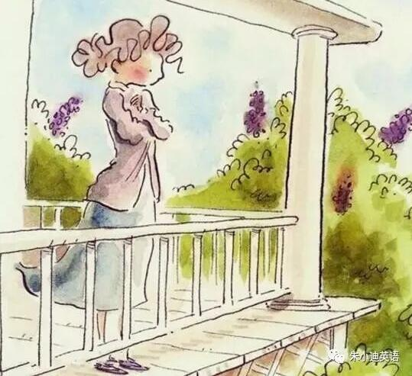
At that leaving time
The mom will feel...
The daughter will feel...
The mom expects her daughter to be ...

Slide 10
Mom
Young lady
Teenager
Child
P15-P18
Baby
P13-P14
P6-P12
P4-P5
P1-P3

Slide 11
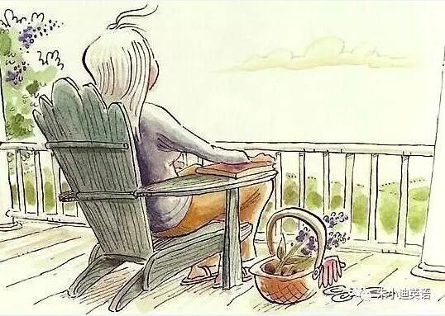
The mom expects her daughter to remember...

Slide 13
Someday by Baby
One day you counted my fingers and kissed each one.
One day the first snowflakes fell ,and held
up and watched them melt on baby skin.
Someday ,a long time from now , own hair will glow
silver in the sun.
‘。。。。。。

Slide 14
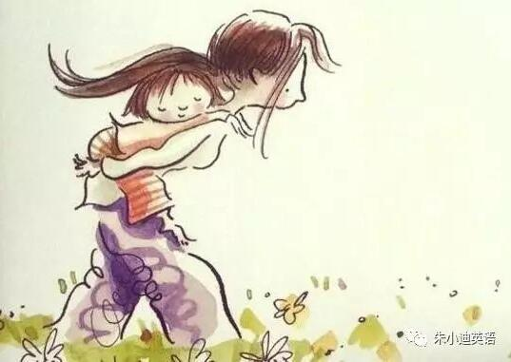
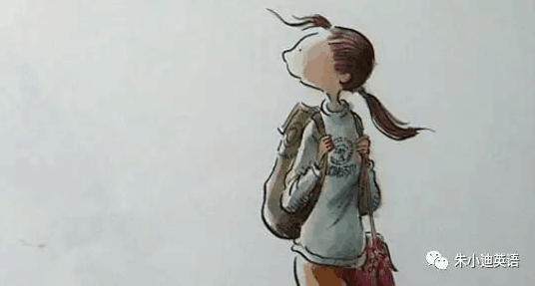
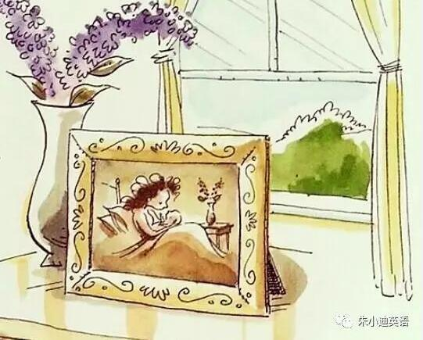
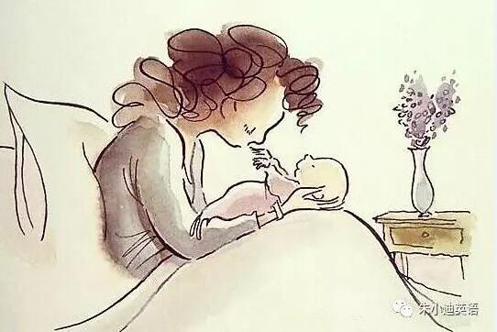
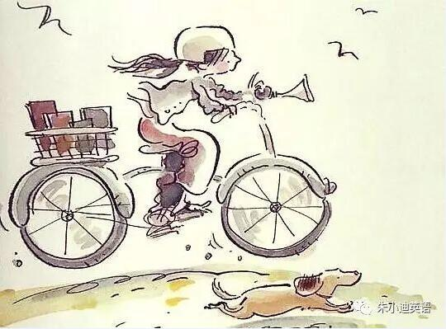
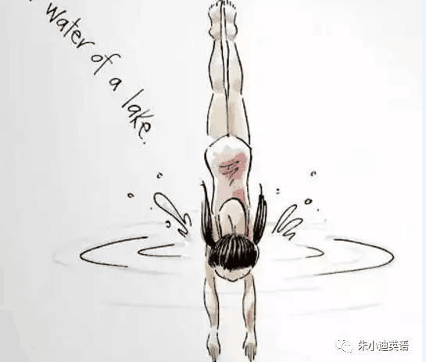

Slide 15
What touches（感动）you the most?
Why?

Slide 16
Say something to your mom......
Someday......

Slide 17
Thank you !

